Slide 1

Securing Your API Endpoints A practical guide to API authentication techniques
@spetryjohnson

Slide 2
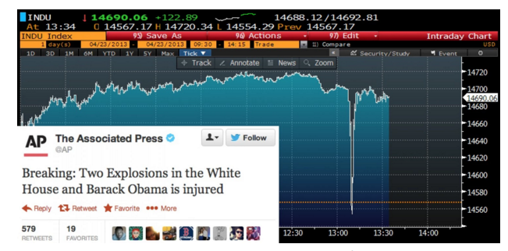
3 minutes; $136 billion lost
Notes:
In 2013, at 1:07pm on a Tuesday, the official Twitter account of the Associated Press tweeted that there had been two explosions at the White House and that Barack Obama had been injured. Over the next three minutes, the Dow dropped 150 points and erased $136 billion in equity market value.
Fortunately the hoax was quickly exposed and the market quickly regained value. But 3 minutes is an eternity in a world of high-frequency trading algorithms, plenty of time to take advantage.
That damage was done by a hack on a single account. What if lots of Twitter accounts were hacked at the same time?
https://www.washingtonpost.com/news/worldviews/wp/2013/04/23/syrian-hackers-claim-ap-hack-that-tipped-stock-market-by-136-billion-is-it-terrorism/

Slide 3
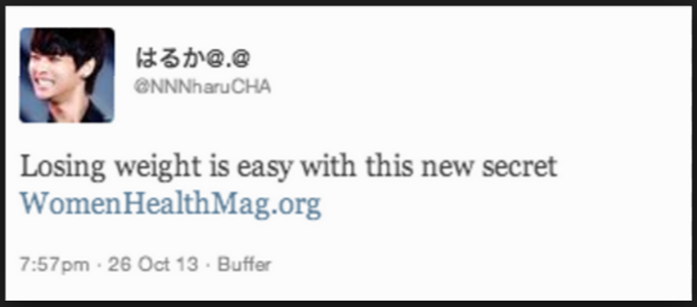
30,000 spammed accounts
Notes:
Also in 2013, nearly 400,000 Twitter and Facebook OAuth access tokens were compromised for a social media publishing service called Buffer.
Within 10 minutes, spam message ads were posted on behalf of 30,000 compromised users.
Also shut down quickly, but even in 10 minutes damage could have far exceeded spam ads.
Manipulated financial markets
Incited panic
Spread malware

Slide 4

Nissan Leaf exploit
Notes:
This one’s a little more recent. In February of this year, it was reported that the vehicle control app for the Nissan Leaf performs no API authentication whatsoever.
If you know the VIN number for a LEAF, you can turn the climate control on or off, access battery status, and access the complete driving history over the internet.

Slide 5
The cost of leaked data
87% of the US population uniquely identified by { birthdate, gender, zip code }
Notes:
You don’t have to be a high profile target like Twitter, or control something as dangerous as a vehicle, to be the target of an authentication attack. Consider this, the ultimate purpose of an attack might be to string lots of small exploits into something larger.
Here’s a scary fact: 87% of the US population are uniquely identified by these three pieces of data.
If you use same address on multiple sites, and attacker gets birthdate from one “low value” target, gender another & zip from a 3rd, they can now de-anonymize you in other databases.
It can use that data to stage social engineering attacks or to conduct identity theft.
Point is that even “low value” targets need to take API security seriously. One way to do that is to properly authenticate API calls

Slide 6

Rookies, amirite!?
Notes:
To get started, I have a confession to make.
My team develops a fairly standard web app with session state and server rendered HTML. We eventually want to build a mobile app…
RESTful APIs are normally stateless…. Need authentication.
I did a little research and found a pretty confusing mess:
Bearer tokens, nonces, federated identity
Correct cryptographic hash function when signing requests
Two different versions of this thing called Oauth
There was no “guide to choosing the right authentication for you”
So… I did a bad thing. In a hurry, rolled my own, got it wrong.

Slide 7
Today’s goal: No more rookie mistakes!
Notes:
My goal today is to give you the coherent overview I desperately needed a few months ago.
I’m going to break down all of the complex terminology and compare and contrast the different techniques you can choose from.
Next time that you need to choose how to secure an API endpoint, I want you to start from a place of knowledge so that you can make an educated decision and not a rookie mistake.

Slide 8
What’s on the agenda?
Identity vs Authentication vs Authorization
Compare/contrast security techniques
Finding the best one for YOU
Notes:
Here’s the basic structure of this talk.
First, we’re going to talk about three different concepts that you, as an API author, should be thinking about when choosing an authentication solution.
Then we’ll compare and contrast the options you can choose from when authenticating your API calls. We’ll cover everything from HTTP Basic Auth to OpenID Connect.
Finally, we’ll wrap up with some suggestions for selecting a technology to match your use case.
The majority of this talk is platform agnostic. As we go through the different options I may talk briefly about implementation details on the IIS/.NET platform, but mostly I’ll be showing you diagrams rather than code.

Slide 9
This is not an advanced security session!
Notes:
Also, I want to be clear about what this session is NOT.
First, it’s not an advanced security session. If you already know the difference between OAuth 1 and 2 and which authentication options require SSL and which don’t, or if you already know how to sign a request using HMAC, then you’re probably in the wrong place. My intended audience is people who DON’T know those things, or even that those are the things they need to know about in the first place.

Slide 10
This is not “getting started with <foo>”
Notes:
Second, this is not a “getting started with foo” style talk. In order to cover everything I want to cover I’m going to have to stay pretty high level.
In fact, there are things in this talk that I have no direct hands on experience with. We’re going to talk about OAuth in a bit but I’ve never personally written any OAuth code.
However, I have done a lot of research about OAuth and how it compares to the other options, and that’s what I’m offering to you today.

Slide 11
This is “understand the options”
Notes:
This talk is a summary of hours and hours of research, distilled into the most digestible format I could create. I want to help you narrow the universe of possibilities to the one or two techniques that are most suitable for your use case, but you’ll have to look elsewhere for a more in-depth Hello World tutorial on whatever you pick.

Slide 12
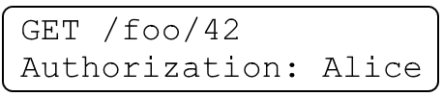
Identity / Authentication / Authorization
Identity: user data
Authentication: which user is this request for?
Authorization: is this request permitted?
Notes:
Subtitle is “A practical guide to API authentication” but actually talk about three different concepts: “identity”, “authentication”, and “authorization”.
Related but different – need to consider separately when making security decision.
Identity is your app’s concept of a user
Authentication is process through which we securely associate an identity with a request
Authorization is process through which we validate IDENTITY’s PERMISSION to perform
Just because a request is authenticated doesn’t mean its authorized, and just because a request is authorized doesn’t mean its authenticated. We’ll talk about that in a minute.

Slide 13
Identity / Authentication / Authorization
Not all APIs care about all 3 things
Access control often your app’s responsibility
Notes:
Not all APIs care about all of these things.
Google API key for IDENTITY = rate limiting
Twitter cares about all 3
Point is that before you can pick an authentication strategy, you need to understand what problems it needs to solve.
Lastly, no matter how you authenticate, your app will still be responsible for some amount of access control.
Your custom business rules are the only thing that can know for sure if Alice is allowed to view data for Foo #42.

Slide 14

Step 1: Use OAuth
Step 2: Profit!
Notes:
So, how do you authenticate and secure your API endpoints? I wish it was as simple as saying "step 1. Use OAuth. There is no step 2”.

Slide 15

Well….
… maybe not.
Notes:
Unfortunately, it’s not that simple.
There are actually 2 different versions of OAuth, which work very differently from each other, as well as numerous other techniques you could use, each with its own set of tradeoffs. Like most things in computer science there’s no One True Way that is best in all scenarios.
(Don’t tell Bethesda I used this!)

Slide 16
And the contestants are…
Client Certificates
HTTP Basic Authentication
Digest Authentication
API Keys
HMAC
JWT
OAuth 1.0
OAuth 2.0
OpenID Connect
SAML
WS-Security
Notes:
Here are all the things we’re going to talk about today.
Some of these things are implemented at the web server, some of them use heavy frameworks, some of them require custom code. Some of these are very enterprisey, others are less so. Some of these I’ll cover in more detail than others, but when you leave here today I want you to understand how each of these things relates to the others and have a sense of how easily you could implement them.

Slide 17
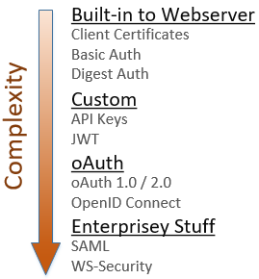
Notes:
Here are all the things we’re going to talk about today.
I’ve organized all of the various options into 4 categories:
* Standards-based things directly supported by your web server, require very little code
* Custom implementations require more code, provide more flexibilty
* Different flavors of oAuth
* Some very enterprisey things that I won’t get into today, but you should at least know that they exist
Again, this session is not a tutorial on how to actually implement any of these. I’m going to zip through these pretty fast, I just want you to understand how they relate.

Slide 18
SSL is broken! Use TLS
Notes:
Real quick sidebar: I assume that everyone here understands the idea of a secure connection in which the communications between a client and server are encrypted. Some of the techniques I’ll discuss require a secure connection, some don’t.
The important thing to note is that SSL is a broken system, it’s not secure. Make sure your servers are set up to use TLS instead.
If I say SSL any other time during this session, it’s just an old habit. I mean TLS.

Slide 19
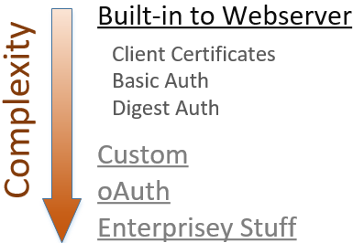
Authentication built-into the web server
Notes:
The simplest way to secure your API is to use the authentication features built directly into your web server platform.
These 3 solutions are standards-based, are supported by all major web servers, and using them generally requires very little custom code. If you need something quick and dirty, start here.

Slide 20
Client certificates
“Reverse TLS” – proves client identity to server
No usernames or passwords
Ideal for internal apps, not public facing
On IIS, only “simple” w/ Active Directory
Notes:
The 1st of those techniques is “client certificates” = “reverse TLS”. In TLS, cert on server proves identity to client.
Client certs do the same thing, but in reverse. You install the certificate on your browser, and it proves your identity to the server
No login screens, no redirects, every request instantly authenticated.
Drawbacks:
1) all users have to install security certs. Doesn’t scale.
2) In Windows land, this is only “simple” when using Active Direct
http://www.networkworld.com/article/2226498/infrastructure-management/simply-put-how-does-certificate-based-authentication-work.html

Slide 21

HTTP Basic Authentication
Notes:
If you don’t want to deal with client certs, the next simplest approach is HTTP Basic Authentication.
* Internet standard, supported by all major browsers, easy
* Credentials are Base64 encoded and sent with each request as a header
* The “Authorization” header is named poorly. Authentication, not authorization.
http://www.asp.net/web-api/overview/security/basic-authentication

Slide 22
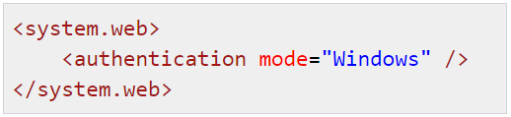
HTTP Basic Authentication
Active Directory supported “out of the box” on IIS
Easily authenticate against custom database (ASP.NET, WebAPI, OWIN)
Notes:
Setting up Basic Auth is really easy. If you’re using IIS, you get authentication against a Windows domain “for free” with a simple web.config setting.
For a public-facing website you’d probably want to authenticate against your custom membership system. In ASP.NET or WebAPI you can do that by writing some simple middleware and overriding a few methods.

Slide 23
HTTP Basic Authentication - drawbacks
Credentials passed as clear text – requires TLS
Revoking access requires password change
Notes:
Two main drawbacks:
1) API client has access to the primary account password
Only way to revoke access to that client is to change the account password
Impacts ALL connected integrations
2) Credentials passed on every request & in the clear.
Remember that Base64 encoding is reversible
Use TLS on every secured request, because TLS encrypts the request as it travels over the wire
Only as secure as the TLS implementation

Slide 24
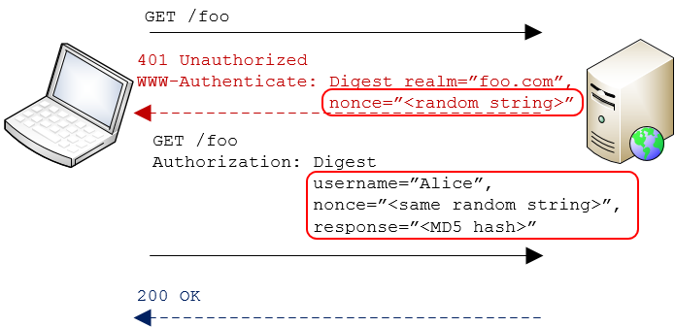
HTTP Digest Authentication
Notes:
An alternative to Basic Auth is another Internet standard called Digest Auth
Main difference is that with Digest, the password is never sent over the wire.
Clients makes a secured request
Server responds “not authorized” & includes a “nonce”
Client uses nonce to create an MD5 hash of the username and password
Clients resubmits request, passing username and nonce in clear text + hash
The server looks up the user’s password, re-calculates hash, verifies request
Only way hashes match is if both client and server used same password to calc hash == proof of identity

Slide 25
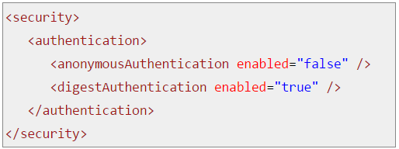
HTTP Digest Authentication
TLS not required
Active Directory supported “out of the box” on IIS
Easily integrates w/ other standards-based systems
Notes:
Since password is never sent over wire, TLS not required
Just like with Basic Auth it’s very easy to integrate with systems that support the standard.

Slide 26
HTTP Digest Authentication - drawbacks
For every request, client makes two calls to server
Prevents storing passwords with strong encryption!
Notes:
However, there are some significant drawbacks to Digest.
First, it’s a little less efficient than Basic Auth because a new nonce has to be obtained from the server for each request
The main issue is that Digest prevents use of strong password encryption in your user database.
* Must have access to raw password to verify hash.
No one really uses Digest Auth, but it’s important to understand the concept because we’ll see it again later.
http://unixpapa.com/auth/basic.html

Slide 27
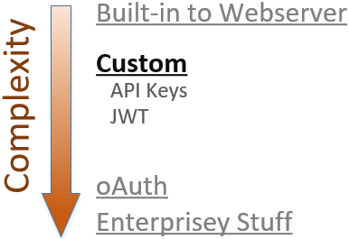
Custom scheme: API Keys and JWT
Notes:
Those 3 things work great if you want the API client to present actual user credentials during authentication, and if you’re OK with the constraints those techniques include. But what if those constraints are too limiting?
If you need more flexibility, either in terms of what information you use to authenticate OR how that information is transmitted, then the next simplest approach is to implement a custom scheme using API Keys or JSON Web Tokens.

Slide 28
API Keys
Used in place of username/password combo
Revocable
Usually a GUID – hard to brute force
Use as “bearer token” or to “sign” a request
Notes:
Let’s talk about API keys first.
* Primary benefits are
Keeps the primary account credentials safe because they are never exposed to a client
Allows each client to have its own unique key to the same account. You can decide to let one Twitter client post to your timeline while another can only read, and you can revoke either of those permissions without impacting the other client.
You’re replacing two pieces of info with one, so it needs to be hard to brute force like a GUID
There are two different ways to use API keys for authentication.

Slide 29


API Keys as passwords (“bearer tokens“)
Via querystring (using TLS)
Via header (using TLS)
Notes:
Simplest way to use API keys is to treat them like a password & pass with each request, in plain text
* Analogous to Basic Auth – requires TLS
You can pass the API Key in either the querystring or an HTTP header.
querystring really easy to do - ideal for scripting scenarios
Header is more secure – not in log files
Header can’t be leaked via copy/paste

Slide 30
API Keys as passwords (“bearer tokens“)
Anyone that has the key, gets access
Only as secure as the TLS implementation
Should salt and hash keys for storage
Notes:
Using keys like this makes them “bearer tokens”, which is basically a password. Whomever possesses the token may use it for authorization
This means you MUST use TLS on all requests, to keep the keys safe in transit. Only as secure as TLS impl
SHOULD encrypt API keys in your database, just like passwords.
If store as text, and DB is compromised, users get impersonated
That’s what happened w/ Buffer
Can’t show users a list of their keys. AWS and Octopus Deploy let you associate human readable name

Slide 31
API Keys as cryptographic keys: HMAC
Signed requests == sensitive values not transmitted
Server ensured of message authenticity
Does not require TLS to keep secret safe
Notes:
The other way to use API Keys is to use them as a cryptographic key, and digitally sign the HTTP request.
Just like we saw with Digest Auth, the idea behind “signing” a request is
Server and client both know some secret value
Client uses the secret to create a hash
Server uses the secret to verify the hash
The secret itself is never transmitted, so does not require TLS
Might use TLS if the message itself is sensitive, but unlike bearer tokens, an attacker that intercepts the message does not gain anything sensitive except the message itself

Slide 32
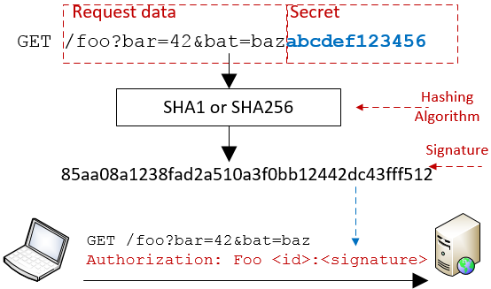
Notes:
Here’s how it works:
The client prepares its message, which in our case is probably a URL like http://foo.com/bar?bat=42
The client concatenates the secret value with that message and then runs it through a hashing algorithm to generate a signature
The client sends the original message to the server, plus the signature in an authorization header.
The server receives the message and repeats the same hashing operation, then compares the result with the value from the authorization header. If they match, it knows the message was created by someone that knows the secret value AND that the message wasn’t modified in transit. (If either of those things is false, the server would have computed a different hash)
Technically speaking the authorization header is a type of “message authentication code”, or MAC. Since this technique uses a hash it’s called a “hash-based message authentication code”, or HMAC.

Slide 33
Signed requests using HMAC
Verifies identity w/out bearer tokens
TLS not required
Proves request was not modified in transit
Defend against replay attacks in app code or TLS
Notes:
Signing a request has some benefits. First, as we just discussed, it lets you verify identity without sending secure keys over the wire. This means you don’t have to rely on TLS.
Proves request wasn’t modified – any changes to the request data will invalidate the signature.
Attacker can’t capture one MAC value and use it to authenticate a different request – each unique combination of request data will have a unique MAC.
If you’re not using TLS then defend against replay attacks w/ custom nonce or timestamp

Slide 34
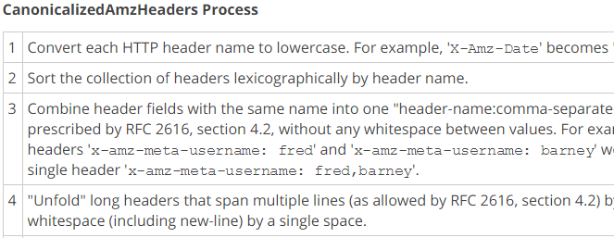
HMAC Drawbacks
Client and server must compute hash exactly same
Notes:
The primary drawback to HMAC is complexity.
* Client and server must compute the hash EXACTLY the same way.
* Usually requires publishing detailed instructions that describe how to “canonicalize” the request data
* Client and server must agree on which headers to include. If middleware network component adds a header to the request, server will calculate different signature.
This image is a tiny piece of just one portion of instructions for canonicalizing an AWS API call.
This complexity is a necessary part of using HMAC. It’s the price you pay for the increased security that signed requests provide.

Slide 35
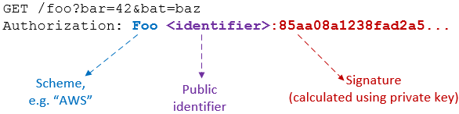
Signed requests using HMAC
Notes:
In order for signing to work, the request must include at least two things:
The signature created with the secret value
An pointer to the identity that created the signature
Identity indicator is required so server knows which secret value to verify with
If you build an HMAC system you’ll have to choose what to use as the identifier and what to use as the secret value.
Internal APIs can use member ID or PK
Public APIs will probably want to use an API Key
In any case, must be something OK to transmit over the wire
If you use the API Key as the public identifier, what do we use as secret value?

Slide 36
HMAC: What to use as “secret value”?
Must be something app can retrieve in clear text
Salted/hashed passwords won’t work
Issue API Keys as a pair: public API Key + private key
Add expiration timeout if necessary
Notes:
Whatever value you choose to use as the secret, it must be stored in plain text or using reversible encryption. App needs it to verify sig.
Can’t use the user’s password. Whole point of secure password storage is to prevent app from knowing actual password.
If hashing and salting password, server only knows the encrypted password, not the text password
A popular approach is to issue API Keys as a pair of values
Public API key, that is transmitted over the wire
Private key that is only known by the client and server.
Storing in text means it can be compromised if an attacker gains access to your database. To combat this, implement an expiration policy for your API Keys

Slide 37
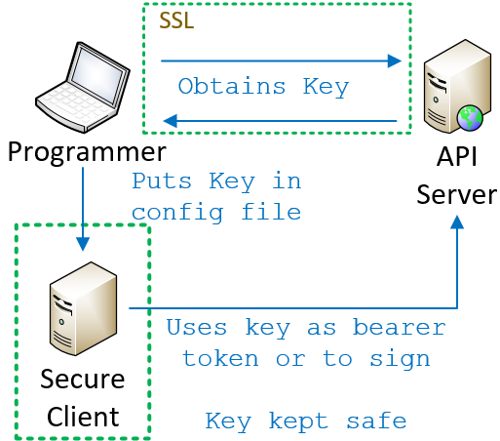
API Keys: Great for server-based clients
Notes:
The last detail of an API Key implementation that you need to think about: how does the client come to know the key in the first place?
Regardless of whether you’re using bearer tokens or HMAC, the client must know the secret value.
If you’re writing a server-based client it’s easy.
* Programmer obtains the secret value using some secure mechanism * Puts it into the source code or config file for the client.
The client is secure, so as long as your’re either using bearer tokens and TLS or HMAC, the key itself is never exposed.

Slide 38
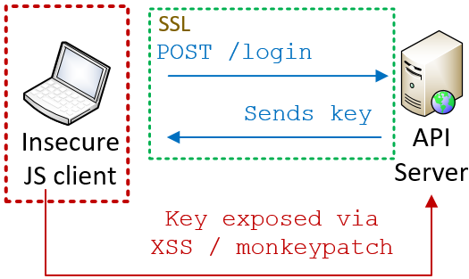
API Keys: Less great for JS clients
Notes:
More complicated for a JS client.
* No way to pre-load the key up front; users can log in from any browser at any time
* Generally speaking, you need the user to actively authenticate themselves by logging in.
* Once authenticated, an API or encryption key could be securely transmitted back to the client, but the client cannot securely store it
* That’s because JS is not a secure environment. Crypto functions can be monkey patched, local storage is susceptible to XSS
* As a rule, you should assume that anything you expose to JS is open for inspection
So if we can’t store the API or encryption keys in JS, how do we secure an API for a JS client?

Slide 39
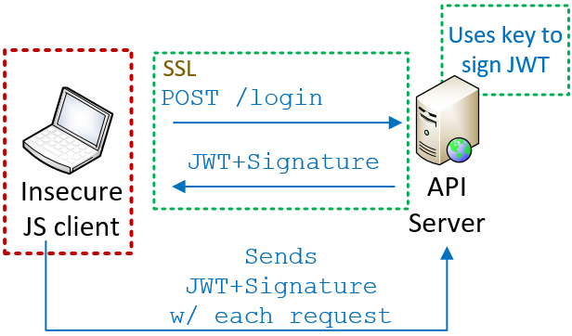
JWT: Secure tokens for JS clients
Notes:
One answer is JSON Web Tokens, pronounced “JOT”
In this approach, the user still needs to securely authenticate themselves by logging in. Once their credentials are validated, the server creates a token indicating that the user has authenticated. The server uses its private encryption key to sign the token and then returns the token and the signature back to the browser.
On each request, browser re-submits token + signature, which server verifies it by re-computing the signature.
This is very similar to HMAC signing the request. If the token and signature match, then the server knows the token is legit and wasn’t modified in transit.
As long as the token itself doesn’t contain any sensitive values, there’s no risk.

Slide 40
Format of a JWT token
Tokens contain mix of standard & custom “claims”
Tokens are self-contained and stateless
Tokens are HMAC signed; request is not. Use TLS.
Tokens are not encrypted, unless you also use JWE
Notes:
From a high level, this is what you need to know about JOT.
1) It’s a standard for the secure transmission of JSON objects. These objects contain “claims”, which are really just data properties of the JSON object. Some of those properties are defined by the standard, but you can add custom claims as well.
2) Tokens are self-contained and stateless. This makes them a good fit for APIs when you cannot associate clients with any server-managed state or session
3) The tokens themselves signed via HMAC, so they are tamper proof. The request body is not signed. If you’re concerned about the request being modified in transit,, use TLS.
4) The tokens themselves are encoded, but not encrypted. Avoid storing anything sensitive in the claims themselves, or use JSON Web Encryption to encrypt the token.

Slide 41
JWT: Secure tokens for JS clients
Tokens contain mix of standard & custom “claims”
Tokens are self-contained and stateless
Tokens are HMAC signed; request is not. Use TLS.
Tokens are not encrypted, unless you also use JWE
Notes:
From a high level, this is what you need to know about JOT.
1) It’s a standard for the secure transmission of JSON objects. These objects contain “claims”, which are really just data properties of the JSON object. Some of those properties are defined by the standard, but you can add custom claims as well.
2) Tokens are self-contained and stateless. This makes them a good fit for APIs when you cannot associate clients with any server-managed state or session
3) The tokens themselves signed via HMAC, so they are tamper proof. The request body is not signed. If you’re concerned about the request being modified in transit,, use TLS.
4) The tokens themselves are encoded, but not encrypted. Avoid storing anything sensitive in the claims themselves, or use JSON Web Encryption to encrypt the token.

Slide 42
API Key recap
Uniquely identify a user (and optionally some perms)
When used as a password:
Must use TLS
Should store them securely
Prefer passing via header, not querystring
No way to verify message integrity
Notes:
We just covered a lot of ground, so let’s do a quick recap of API-key based authentication.
* used instead of usernames/passwords
* uniquely identify a specific user and are sometimes associated with specific permissions
When used like a password,
* the API Key is passed in a URL parameter or a header w/ each request
* requests MUST use SSL to protect the key in transit
* server SHOULD store the keys in a secure fashion
* No way to verify message integrity

Slide 43
API Key recap
When used to “sign” requests (HMAC)
Public API Keys are paired w/ private key
Server cannot store private keys w/ 1-way encrypt.
Proof of identity [authentication] without TLS
Signing proves request wasn’t modified in transit
Notes:
When API Keys are used to sign requests
* each public API Key must be paired with a private key that is kept secure
* Private keys must be stored as text or reversible encryption
* Does not require TLS, unless the API call itself is sensitive
* Guarantees message was not modified in transit

Slide 44
API Key recap
API keys are great for server to server API calls
If using API keys in lieu of sess
Notes:
Signed requests are great for server-to-server API calls
Also doable on mobile or JS, but at some point you’ll end up storing the private key on the client.
Consider assigning a temporary API Key upon login or just use SSL and avoid the complexity of signing requests

Slide 45
OAuth
For both 2-party and 3-party scenarios
OAuth 1.0a vs 2.0
Authorization, not authentication!
Notes:
At this point we’ve discussed some authentication schemes that are supported natively by the web server itself and we’ve discussed some custom systems based around API Keys. Next on the agenda is Oauth.
One of the reasons that we talked about those other thing first is because OAuth uses many of the same concepts and it’s easier to understand once you understand the underlying patterns.
We’re going to discuss a few different things: the difference between 2- and 3-party authorization, the differences between OAuth versions 1.0 and 2.0, and what it means for OAuth to be an authorization framework, not an authentication one.

Slide 46

Client/server authentication (2-legged)
Client is resource owner; access its own data
Notes:
OAuth was originally designed to solve the problem of “delegated authorization” in a 3-party scenario.
To explain that, let’s first review the traditional 2-party scenario you see here.
Client uses ITS credentials to access ITS resources on the server. In OAuth parlance, this is a “2-legged” model because there are two entities involved. One scenario that uses this model is server-to-server communication.

Slide 47
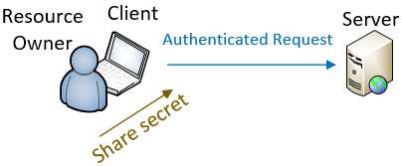
Delegated authorization (3-legged)
Client acts on behalf of the resource owner
Notes:
In other cases, the client is acting ON BEHALF OF of another entity, such as the person using the browser.
In those cases, client is not accessing its own resources but those of the user.
To do this, the user must share their credentials with the client so that the client can use them to make the authenticated request.
In some cases this is fine, like when the website you’re on is the website of the trusted system. By logging you in the first place, you’re explicitly giving that site your credentials in order to authenticate yourself.

Slide 48
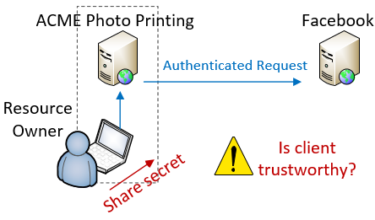
Delegated authorization (3-legged)
Notes:
But what if you DON’T trust the client with your credentials?
Let’s say you have some photos that you’ve uploaded to Facebook and you want to use an online photo printing service to create greeting cards using those photos.
You really don’t want to give ACME your Facebook username and password, but how else does it make the authenticated request on your behalf?

Slide 49
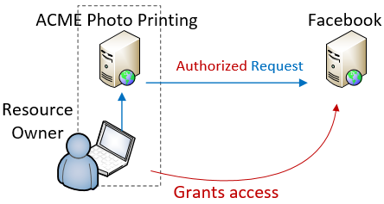
Delegated authorization (3-legged)
Notes:
This is the exact scenario that OAuth was designed for.
“3-legged” model because there are 3 parties involved: the Resource Owner that owns the content, the Service Provider that hosts the content, and the Client that accesses the content.
OAuth allows the Resource Owner to authorize the Client to access the data client on their behalf, but without sharing their actual credentials.
When you do this, ACME is no longer making an AUTHENTICATED request, its making an AUTHORIZED request. We’ll talk about this in a minute.

Slide 50

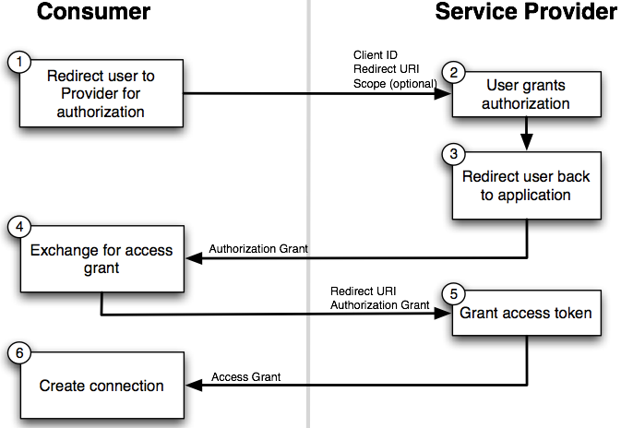
Notes:
Here’s how it works. The user starts out on the client’s website, ACME photos. ACME redirects the user to the provider (Facebook)
Facebook displays a page to the user to collect authorization, which looks like this

Slide 51
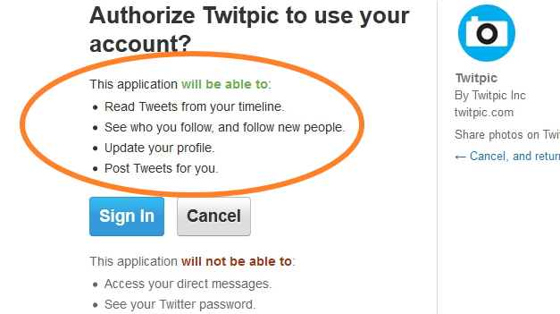
Notes:
This page is hosted by the authorization server, which presumably you trust. It explains the sorts of access that you are authorizing.
If you choose to authorize the access, the OAuth flow continues.

Slide 52
Notes:
User authorizes the access ➔ redirects back to the client with an “authorization grant”.
Client makes another call to service and trades auth grant for an access token
transition
* There are 2 versions of OAuth and they solve this problem in very different ways
* Not universally accepted that the newer version is best

Slide 53
OAuth 1.0a
Uses signed requests (TLS not req. / integrity guaranteed)
3-legged “flow” works best with web-based clients
Complex to implement – use libraries!
Notes:
Published April 2010, 1,0a came out shortly after. When I say “OAuth 1.0” I really mean “1.0a”.
In technical terms, implemented using signed requests.
Does not require TLS
Message integrity is guaranteed
Works best w/ web-based clients b/c user must be sent to a website to do the auth
Primary drawback complexity from signing
Mitigated a little by libraries, but still a lot of work

Slide 54
OAuth 2.0
Not backwards compatible with 1.0/1.0a
No HMAC signatures == simpler to implement
Delegates security entirely to TLS
Better support for enterprise & non-web clients
Notes:
OAuth 2.0 was designed to address those drawbacks. It is an entirely different implementation and the two are not compatible.
Major difference is simplicity
Uses bearer tokens instead of request signing
Requires TLS to keep the tokens safe in transit
OAuth 2.0 also has better support for non-web clients and enterprise use cases.
Provides more “flows” than 1.0
Means there are more supported authentication workflows that can be supported

Slide 55
OAuth 2.0 – drawbacks
OAuth 2.0 is a framework, not a protocol; less interoperable than 1.0a
Notes:
It’s important to note that the 2.0 spec is considered a framework rather than a protocol.
In order to support the wider range of authorization workflows, many decisions are left to implementers
This hurts interoperability.
Two providers may say they are OAuth 2 compliant, and have very different actual implementations
Code you write for one provider may require a lot of work to support a different provider

Slide 56
OAuth 2.0 – drawbacks
OAuth 2.0 and the road to Hell
“When compared with OAuth 1.0, the 2.0 specification is more complex, less interoperable, less useful, more incomplete and, most importantly, less secure.”
Eran Hammer, former lead author of OAuth working group
http://hueniverse.com/2012/07/26/oauth-2-0-and-the-road-to-hell/
Notes:
There’s some controversy around 2.0 as well.
Eran Hammer was the lead author for the OAuth working group
withdrew his name from the 2.0 specification prior to publishing
“OAuth 2.0 and the Road to Hell”

Slide 57
Use OAuth 2.0 if…
OAuth 2.0 and the road to Hell
“If you consider yourself a security expert, use 2.0 after careful examination of its features. If you are not an expert, copy an implementation of a provider you trust… or make sure you have some security experts on site to figure it out for you.”
Eran Hammer, former lead author of OAuth working group
http://hueniverse.com/2012/07/26/oauth-2-0-and-the-road-to-hell/
Notes:
He goes on to say “If you consider yourself a security expert, use 2.0 after careful examination of its features. If you are not an expert, copy the implementation of a provider you trust to get it right or make sure you have some security experts on site to figure it out for you”.
This might just be sour grapes or a difference in vision for OAuth.
Make sure you research before choosing OAuth 2

Slide 58
OAuth is not an authentication protocol!
Notes:
Let’s talk about authentication vs authorization again.
OAuth is a standard for delegating authorization to an API.
About you, as a Resource Owner, authorizing one application to access your data from another application.
It is not an authentication protocol and should not be used as one, for two reasons.

Slide 59
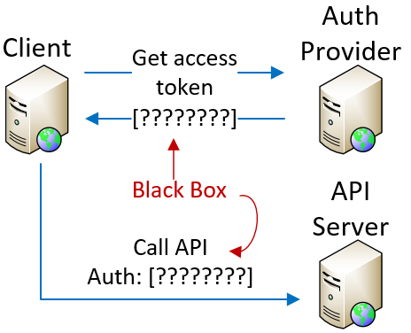
Access tokens are opaque - don’t provide ID
Notes:
First, whole point of authentication is to securely associate identity with request.
OAuth access tokens don’t tell the client anything about user identity.
By definition, access tokens are opaque to the client.
Client gets token from auth provider
Client uses token to make API calls
Token itself is a black box – client can’t parse it or extract data
Therefore, the access token alone is insufficient to provide authentication data to the client.

Slide 60
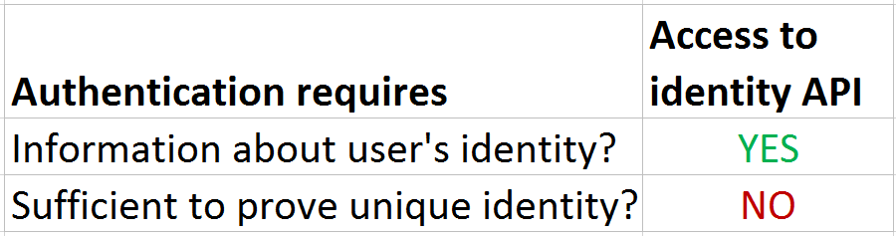
Access to identity API != authentication
Notes:
But what if the access token authorizes you to call an API that will provide user identity information?
If you have a token, & token authorized to obtain identity information, is that sufficient for authentication?
NO, because no guarantee that only that user was able to authorize that access. If more than one entity can delegate access to that identity API, then you can’t assume that your authorization is sufficient for authentication
This might be easier to understand with an example.

Slide 61
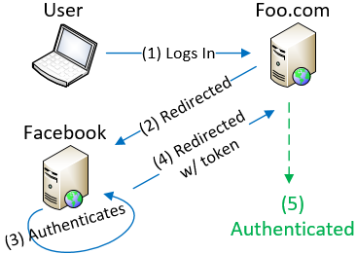
Access tokens lack audience restrictions
Notes:
Let’s say there is a website that lets people “log in with Facebook”.
I go to Foo.com and follow normal OAuth flow and authenticate against Facebook,
I authorize Foo.com to access my data and get redirected back to Foo.com with an access token.
Foo.com uses token to make an API call to Facebook’s API, gets my data, and logs me in.
I have given Foo access to my profile and in exchange, Foo gives me access to my account on their system
In this scenario, Foo would be correct in considering me an authenticated user.

Slide 62
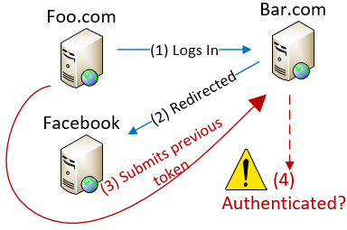
Access tokens lack audience restrictions
Notes:
Let’s say Foo.com isn’t trustworthy. It turns around and makes a login request against Bar.com, which also allows Facebook logins.
Instead of going through Auth process, Foo resubmits the access token they obtained from my authorization
Bar uses that access token to call Facebook’s API and is given my data
Bar then assumes that Foo has authenticated as me, so Foo is logged in and given access to my account with BAR
Neither Foo nor Bar have more access to FB data than was authorized
Foo has impersonated me at BAR and can access Bar’s data associated with my account
Possible because OAuth access tokens do not have audience restriction. This is a problem with bearer tokens, Bar doesn’t know that the access token is being misused.

Slide 63
Access token != authentication
Access tokens ONLY mean you can access specified resource
If you implicitly treat resource access as authentication, you are vulnerable to impersonation
Notes:
To avoid that problem, ONLY use access tokens to access the authorized resource.
If you use possession of an access token as proof of authentication, you are vulnerable.
To solve this problem, the access token would need to
assert which client it was granted to and
which authenticated identity authorized it
That way, only that one authorized client would be able to use the token, and the token itself would provide the necessary identity information.

Slide 64
OpenID Connect
Open standard, built on top of OAuth 2.0
ID Tokens – gives authentication data to client
Audience restrictions
Enables authentication against 3rd party identity providers
Notes:
That’s the basic concept behind OpenID Connect.
Open standard that defines an interoperable identity layer on top of OAuth 2.0.
Allows authentication against 3rd party identity providers by closing some of the gaps we just mentioned.
ID Connect adds extra tokens which are given to client in addition to regular OAuth access token.
These have well-known format so the client can extract identity claims and audience restrictions directly from the token.
OpenID Connect replaces OpenID 2.0 and is the best way to implement something like “Log in with Google” on your app.

Slide 65
Enterprisey options
SAML
Ideal for SSO w/ centralized identity source
WS-Security
Transports other than HTTP
Multiple encryption keys in use
Messaging across trust domains
Notes:
To wrap up our list I want to touch very briefly on two additional technologies that you should be aware of. These technologies are designed for SOAP web services and/or for complex authentication scenarios that occur in the enterprise.
The first is SAML, which stands for “Security Assertion Markup Language”. It’s an “XML-based, open standard data format for exchanging authentication and authorization data between parties”. Although technically designed for applications on the internet, SAML is generally used in enterprise SSO scenarios.
The second is WS-Security. In terms of complexity, this is the undisputed king. It is designed for very complex scenarios that I’m guessing no one in this room needs to deal with. All I’m going to say is that if your use cases involve things like this then you should be seeking out some professional consulting services. My freebie session at CodeMash ain’t gonna cut it for you.

Slide 66
So what should you use?
Notes:
So what should you use?
I just threw a ton of choices at you, and as usual the correct answer is “it depends”.
Let’s briefly recap those options and talk about the ideal use cases for each.

Slide 67
Choose your own adventure
Consider client certificates if…
You’re using IIS + Active Directory (or equivalent) to secure a private API on trusted network, or
You want server-to-server authentication w/out passwords
Notes:
Client certs are useful if you can get users to install them
Bad choice for public API
Work best for securing private API on trusted network.
In Windows land, the sweet spot is when using IIS and Active Directory, because the tooling to link certs to identities already exists.
Also a good fit for server to server auth because you don’t have to manage passwords

Slide 68
Choose your own adventure
Consider HTTP Basic Auth if…
You want to write as little code as possible, and
You don’t care about the login UI, and
You can tolerate TLS on all requests
Best for server-to-server API calls
Notes:
Basic Auth is ideal if
You want to write very little code, and
You don’t care about the crappy login UI, and
You’re comfortable using TLS on all requests because you’re sending unencrypted passwords with each request
An ideal use case is server to server API calls where you can’t use client certs.
This approach is only as secure as your use of TLS.

Slide 69
Choose your own adventure
Consider HTTP Digest Auth if…
Don’t. Just don’t.
Notes:
There’s no good reason to use Digest Auth.

Slide 70
Choose your own adventure
Consider custom API Keys as bearer tokens if…
Your app owns the data the API cares about, and
You value simplicity over security, and
You can require TLS
Notes:
You should consider using API keys as bearer tokens if
Your app operates on data it owns, rather than 3rd party data
You prefer the simplicity of bearer tokens over signing
You’re comfortable relying entirely on TLS to keep your AKI keys safe in transit

Slide 71
Choose your own adventure
Consider custom API Keys and signed requests if…
Your app owns the data the API cares about, and
You can’t/don’t want to rely on TLS
You are writing both client & server
Great for server-to-server communication
Notes:
If your app owns the data and you want more security than passing them as bearer tokens, then consider using signed requests.
Remember that creating the signature can be complex
client and server must do it in the same way
Better choice if you’re writing both client and server.
3rd party client support means you’ll need to document and support canonicalization process
Ideal for server to server API calls.

Slide 72
Choose your own adventure
Consider OAuth 1.0a if…
Data are owned by another party, and
You’re writing a web-based app, and
You can’t/don’t want to require TLS, and/or
You care about client/provider interoperability
Notes:
If your API deals with data owned by another party then OAuth is the way to go.
Also good fit if you’re supporting 3rd party clients.
Consider version 1 if
You’re writing a web-based app, and
You can’t or don’t want to rely on TLS for security
You might also consider version 1.0a if you want to minimize the code you need to write to interact with multiple providers
The primary drawbacks with OAuth 1.0 are
complexity involved in making signed requests
limited support for non-browser clients

Slide 73
Choose your own adventure
Consider OAuth 2.0 if…
Data are owned by another party, and
You want to avoid complexity of signed requests, or
You need to support a wider set of devices and “flows”
Notes:
Use OAuth 2 if
You want to avoid complexity of request signing in OAuth 1 or
You want to support non-web clients or alternative authentication flows
The primary drawbacks to OAuth 2.0 are reduced security and less interoperability; code that you write for one OAuth 2 provider may require a lot of work to support another.

Slide 74
Choose your own adventure
Consider OAuth 2.0 + OpenID Connect if…
You need to authenticate against 3rd party identity data
You want to centralize your own authentication and identity systems
You want SSO without SAML
Notes:
Remember that OAuth by itself is for authorization only.
If you want to authenticate against 3rd party data then use OpenID Connect on top of OAuth 2.0. This will let your users authenticate to your API with their Google accounts, for example.
You can also use OpenID Connect if you have multiple internal systems and you want to set up your own centralized Identity and authentication provider.

Slide 75
Choose your own adventure
Consider SAML or WS-Security if…
You suffer endlessly in Enterprise Hell, or
You find XML to be life-affirming and joyful
Notes:
Lastly, you should use SAML or WS-Security if you literally have no other choice, and/or have a sick love affair with XML.
If you choose either of these, good luck but don’t ask me if you have questions.

Slide 76
3 key things to remember
Requests must use TLS, or be signed w/ MAC
If you are authenticating against your data, consider API Keys
OAuth is for authorization, not authentication. Use OpenID Connect for 3rd party authentication
Notes:
Research shows that attendees of a talk such will generally remember only 3 things. That means that most of the information I just shared with you will vanish quickly if you don’t act on it.
So here are the 3 most important things I want you to remember:
Requests must use EITHER TLS, OR be signed with a MAC. If you’re passing sensitive data over the wire then use SSL. If you want to verify message integrity, use a MAC.
If you own the data that your API deals with, or if you’re writing the server AND the client yourself, then custom API keys may be simpler than using OAuth. You can use API keys as bearer tokens or to sign requests, depending on your needs.
3) OAuth is for authorization, not authentication. Use OpenID Connect if you need both.

Slide 77
That’s all, folks!
Materials
www.petry-johnson.com
github.com/spetryjohnson
Contact
@spetryjohnson
seth@petry-johnson.com
Notes:
Actually, you all look like smart people, so I want you to try really hard to remember a 4th thing, and that’s my website. From there you can get to my Github where these slides are kept and you can also get to my email, my Twitter, my LinkedIn, etc.
Please feel free to reach out with feedback, questions, comments, etc. I’d love to hear from you.
THANK YOU!

